Slide 1
Introduction to
Conjoint Analysis

Slide 2
Different Perspectives, Different Goals
Buyers want all of the most desirable features at lowest possible price
Sellers want to maximize profits by:
1) minimizing costs of providing features
2) providing products that offer greater overall value than the competition

Slide 3
Demand Side of Equation
Typical market research role is to focus first on demand side of the equation
After figuring out what buyers want, next assess whether it can be built/provided in a cost- effective manner

Slide 4
Products/Services are Composed of Features/Attributes
Credit Card:
Brand + Interest Rate + Annual Fee + Credit Limit
On-Line Brokerage:
Brand + Fee + Speed of Transaction + Reliability of Transaction + Research/Charting Options

Slide 5
Breaking the Problem Down
If we learn how buyers value the components of a product, we are in a better position to design those that improve profitability

Slide 6
How to Learn What Customers Want?
Ask Direct Questions about preference:
  What brand do you prefer?
  What Interest Rate would you like?
  What Annual Fee would you like?
  What Credit Limit would you like?
Answers often trivial and unenlightening (e.g. respondents prefer low fees to high fees, higher credit limits to low credit limits)

Slide 7
How to Learn What Is Important?
Ask Direct Questions about importances
  How important is it that you get the <<brand, interest rate, annual fee, credit limit>> that you want?

Slide 8
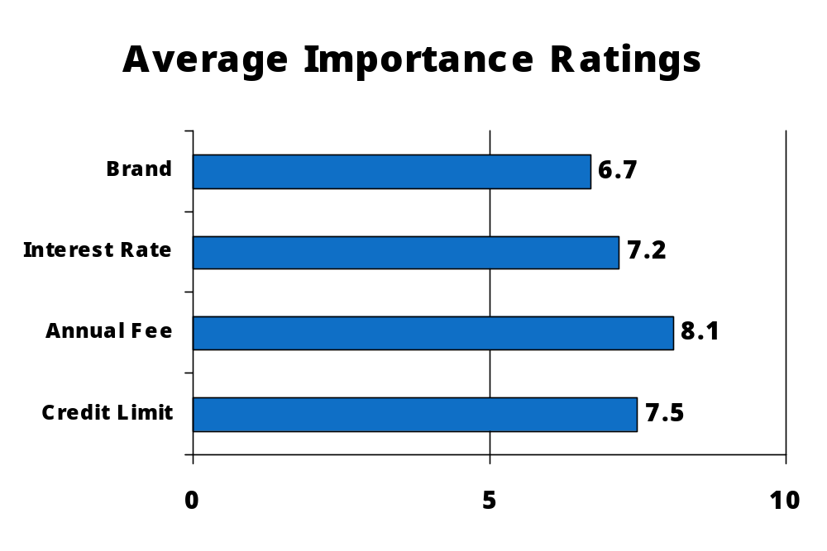
Stated Importances
Importance Ratings often have low discrimination:

Slide 9
Stated Importances
Answers often have low discrimination, with most answers falling in “very important” categories
Answers sometimes useful for segmenting market, but still not as actionable as could be

Slide 10
What is Conjoint Analysis?
Research technique developed in early 70s
Measures how buyers value components of a product/service bundle
Dictionary definition-- “Conjoint: Joined together, combined.”
Marketer’s catch-phrase-- “Features CONsidered JOINTly”

Slide 11
Important Early Articles
Luce, Duncan and John Tukey (1964), “Simultaneous Conjoint Measurement: A New Type of Fundamental Measurement,” Journal of Mathematical Psychology, 1, 1-27
Green, Paul and Vithala Rao (1971), “Conjoint Measurement for Quantifying Judgmental Data,” Journal of Marketing Research, 8 (Aug), 355-363
Johnson, Richard (1974), “Trade-off Analysis of Consumer Values,” Journal of Marketing Research, 11 (May), 121-127
Green, Paul and V. Srinivasan (1978), “Conjoint Analysis in Marketing: New Development with Implications for Research and Practice,” Journal of Marketing, 54 (Oct), 3-19
Louviere, Jordan and George Woodworth (1983), “Design and Analysis of Simulated Consumer Choice or Allocation Experiments,” Journal of Marketing Research, 20 (Nov), 350-367

Slide 12
How Does Conjoint Analysis Work?
We vary the product features (independent variables) to build many (usually 12 or more) product concepts
We ask respondents to rate/rank those product concepts (dependent variable)
Based on the respondents’ evaluations of the product concepts, we figure out how much unique value (utility) each of the features added
(Regress dependent variable on independent variables; betas equal part worth utilities.)

Slide 13
What’s So Good about Conjoint?
More realistic questions:
Would you prefer . . .
210 Horsepower or 140 Horsepower
17 MPG 28 MPG
If choose left, you prefer Power. If choose right, you prefer Fuel Economy
Rather than ask directly whether you prefer Power over Fuel Economy, we present realistic tradeoff scenarios and infer preferences from your product choices

Slide 14

What’s So Good about Conjoint?
When respondents are forced to make difficult tradeoffs, we learn what they truly value

Slide 15
First Step: Create Attribute List
Attributes assumed to be independent (Brand, Speed, Color, Price, etc.)
Each attribute has varying degrees, or “levels”
  Brand: Coke, Pepsi, Sprite
  Speed: 5 pages per minute, 10 pages per minute
  Color: Red, Blue, Green, Black
Each level is assumed to be mutually exclusive of the others (a product has one and only one level level of that attribute)

Slide 16
Rules for Formulating Attribute Levels
Levels are assumed to be mutually exclusive
Attribute: Add-on features
level 1: Sunroof
level 2: GPS System
level 3: Video Screen
  If define levels in this way, you cannot determine the value of providing two or three of these features at the same time

Slide 17
Rules for Formulating Attribute Levels
Levels should have concrete/unambiguous meaning
“Very expensive” vs. “Costs $575”
“Weight: 5 to 7 kilos” vs. “Weight 6 kilos”
  One description leaves meaning up to individual interpretation, while the other does not

Slide 18
Rules for Formulating Attribute Levels
Don’t include too many levels for any one attribute
  The usual number is about 3 to 5 levels per attribute
  The temptation (for example) is to include many, many levels of price, so we can estimate people’s preferences for each
  But, you spread your precious observations across more parameters to be estimated, resulting in noisier (less precise) measurement of ALL price levels
  Better approach usually is to interpolate between fewer more precisely measured levels for “not asked about” prices

Slide 19
Rules for Formulating Attribute Levels
Whenever possible, try to balance the number of levels across attributes
There is a well-known bias in conjoint analysis called the “Number of Levels Effect”
  Holding all else constant, attributes defined on more levels than others will be biased upwards in importance
  For example, price defined as ($10, $12, $14, $16, $18, $20) will receive higher relative importance than when defined as ($10, $15, $20) even though the same range was measured
  The Number of Levels effect holds for quantitative (e.g. price, speed) and categorical (e.g. brand, color) attributes

Slide 20
Rules for Formulating Attribute Levels
Make sure levels from your attributes can combine freely with one another without resulting in utterly impossible combinations (very unlikely combinations OK)
  Resist temptation to make attribute prohibitions (prohibiting levels from one attribute from occurring with levels from other attributes)!
  Respondents can imagine many possibilities (and evaluate them consistently) that the study commissioner doesn’t plan to/can’t offer. By avoiding prohibitions, we usually improve the estimates of the combinations that we will actually focus on.
  But, for advanced analysts, some prohibitions are OK, and even helpful

Slide 21
Conjoint Analysis Output
Utilities (part worths)
Importances
Market simulations

Slide 22
Conjoint Utilities (Part Worths)
Numeric values that reflect how desirable different features are:
Feature Utility
Vanilla 2.5
Chocolate 1.8
25¢ 5.3
35¢ 3.2
50¢ 1.4
The higher the utility, the better

Slide 23
Conjoint Importances
Measure of how much influence each attribute has on people’s choices
Best minus worst level of each attribute, percentaged:
Vanilla - Chocolate (2.5 - 1.8) = 0.7 15.2%
25¢ - 50¢ (5.3 - 1.4) = 3.9 84.8%
----- --------
Totals: 4.6 100.0%
Importances are directly affected by the range of levels you choose for each attribute

Slide 24
Market Simulations
Make competitive market scenarios and predict which products respondents would choose
Accumulate (aggregate) respondent predictions to make “Shares of Preference” (some refer to them as “market shares”)

Slide 25
Market Simulation Example
Predict market shares for 35¢ Vanilla cone vs. 25¢ Chocolate cone for Respondent #1:
Vanilla (2.5) + 35¢ (3.2) = 5.7
Chocolate (1.8) + 25¢ (5.3) = 7.1
Respondent #1 “chooses” 25¢ Chocolate cone!
Repeat for rest of respondents. . .

Slide 26
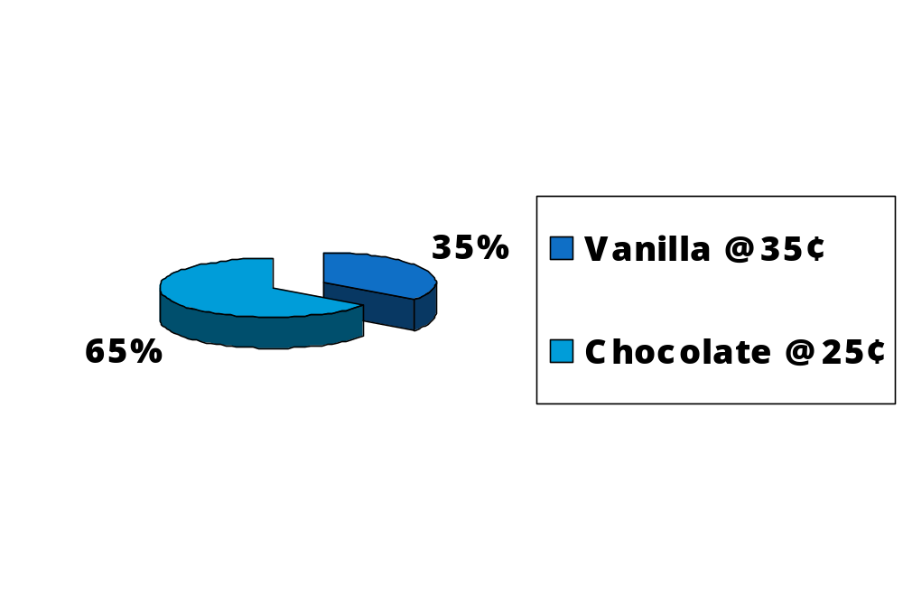
Market Simulation Results
Predict responses for 500 respondents, and we might see “shares of preference” like:
65% of respondents prefer the 25¢ Chocolate cone

Slide 27
Conjoint Market Simulation Assumptions
All attributes that affect buyer choices in the real world have been accounted for
Equal availability (distribution)
Respondents are aware of all products
Long-range equilibrium (equal time on market)
Equal effectiveness of sales force
No out-of-stock conditions

Slide 28
Shares of Preference Don’t Always Match Actual Market Shares
Conjoint simulator assumptions usually don’t hold true in the real world
But this doesn’t mean that conjoint simulators are not valuable!
Simulators turn esoteric “utilities” into concrete “shares”
Conjoint simulators predict respondents’ interest in products/services assuming a level playing field

Slide 29
Value of Conjoint Simulators…
Some Examples
Lets you play “what-if” games to investigate value of modifications to an existing product
Lets you estimate how to design new product to maximize buyer interest at low manufacturing cost
Lets you investigate product line extensions: do we cannibalize our own share or take mostly from competitors?
Lets you estimate demand curves, and cross-elasticity curves
Can provide an important input into demand forecasting models

Slide 30
Three Main “Flavors” of Conjoint Analysis
Traditional Full-Profile Conjoint
Adaptive Conjoint Analysis (ACA)
Choice-Based Conjoint (CBC), also known as Discrete Choice Modeling (DCM)

Slide 31
Strengths of Traditional Conjoint
Good for both product design and pricing issues
Can be administered on paper, computer/internet
Shows products in full-profile, which many argue mimics real-world
Can be used even with very small sample sizes

Slide 32
Weaknesses of Traditional Full-Profile Conjoint
Limited ability to study many attributes (more than about six)
Limited ability to measure interactions and other higher-order effects (cross-effects)

Slide 33
Traditional Conjoint: Card-Sort Method
(Six Attributes)
Using a 100-pt scale where 0 means definitely
would NOT and 100 means definitely WOULD…
How likely are you to purchase…
1997 Honda Accord
Automatic transmission
No antilock brakes
Driver and passenger airbag
Blue exterior/Black interior
$18,900
Your Answer:___________

Slide 34
Six Attributes: Challenging
Respondents find six attributes in full-profile challenging
  Need to read a lot of information to evaluate each card
  Each respondent typically needs to evaluate around 24-36 cards

Slide 35
Traditional Conjoint: Card-Sort Method (15 Attributes)
Using a 100-pt scale where 0 means definitely would
NOT and 100 means definitely WOULD
How likely are you to purchase…
1997 Honda Accord
Automatic transmission
No antilock brakes
Driver and passenger airbag
Blue exterior/Black interior
50,000 mile warranty
Leather seats optional trim package
3-year loan
5.9% APR financing
CD-player
No cruise control
Power windows/locks
Remote alarm system
$18,900
Your Answer:___________

Slide 36
15 Attributes: Near Impossible
Faced with so much reading, respondents are forced to simplify (focus on just the top few attributes in importance)
To get good individual-level results, respondents need to evaluate around 60-90 cards

Slide 37
Adaptive Conjoint Analysis
Developed in 80s by Rich Johnson, Sawtooth Software
Devised as way to study more attributes than was prudent with traditional full-profile conjoint
Adapts to the respondent, focusing on most important attributes and most relevant levels
Shows only a few attributes at a time (partial profile) rather than all attributes at a time (full-profile)

Slide 38
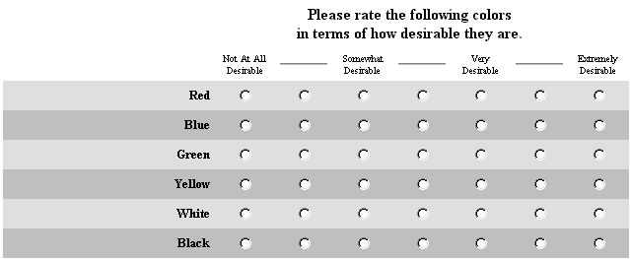
Steps in ACA Survey (1)
Self-Explicated “Priors” Section
  Preference “Ratings” for the levels of any attributes that we do not know ahead of time the order of preference (e.g. brand, color).

Slide 39
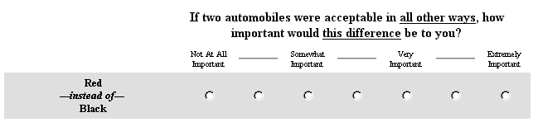
Steps in ACA Survey (2)
Self-Explicated “Priors” Section
  “Importances” Show best and worst levels of each attribute, and ask respondents how important the difference is.

Slide 40
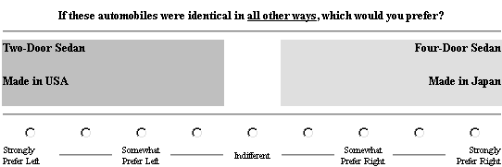
Steps in ACA Survey (3)
Conjoint “Pairs” trade-offs (show only two to five attributes at a time)

Slide 41
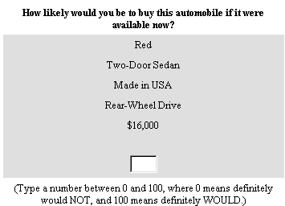
Steps in ACA Survey (4)
“Calibration Concepts” obtain purchase likelihood scores for usually four to six concepts defined on about six attributes (Optional Question)

Slide 42
Adaptive Conjoint Analysis Example
Sample ACA survey

Slide 43
Strengths of ACA
Ability to measure many attributes, without wearing out respondent
Respondents find interview more interesting and engaging
Efficient interview: high ratio of information gained per respondent effort
Can be used even with very small sample sizes

Slide 44
ACA Best Practices
Show only 2 or 3 attributes at a time in the pairs section. More than that causes respondent fatigue, which outweighs the modest amount of additional information.
ACA can measure up to 30 attributes, but users should streamline studies to have as few attributes as necessary for the business decision.
Pretest the questionnaire to make sure it is not too long. If too long, reduce number of attributes, levels, number of pairs questions, or complexity of pairs questions.
Examine pretest data to make sure results are logical and conform to general expectations.
Make sure respondents are engaged in the task: understanding the attributes and levels and being in the market/having an interest in the category.

Slide 45
Weaknesses of ACA
Partial-profile presentation less realistic than real world
  Respondents may not be able to assume attributes not shown are “held constant”
Often not good at pricing research
  Tends to understate importance of price, and within each respondent assumes all brands have equal price elasticities
Must be computer-administered (PC or Web)

Slide 46
ACA Cons
Must be a computerized survey.
Potential double-counting of attributes that are not truly independent.
Respondents may have difficulty keeping in mind that all other attributes not involved in the current question are assumed to be equal.
May “flatten” importances (particularly for low-involvement categories) due to spreading respondents’ attention across individual attributes--but the jury is still out.
Can underestimate the importance of price (especially if many attributes included). CBC and CVA considered better for pricing research.

Slide 47
Choice-Based Conjoint (CBC)
Became popular starting in early 90s
Respondents are shown sets of cards and asked to choose which one they would buy
Can include “None of the above” response, or multiple “held-constant alternatives”

Slide 48
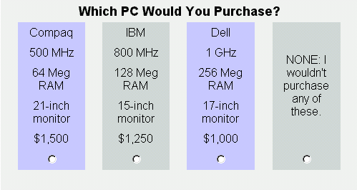
Choice-Based Conjoint Question

Slide 49
Strengths of CBC
Questions closely mimic what buyers do in real world: choose from available products
Can investigate interactions, alternative-specific effects
Can include “None” alternative, or multiple “constant alternatives”
Paper or Computer/Web based interviews possible

Slide 50
Weaknesses of CBC
Usually requires larger sample sizes than with CVA or ACA
Tasks are more complex, so respondents can process fewer attributes (CBC recommended <=6)
Complex tasks may encourage response simplification strategies
Analysis more complex than with CVA or ACA

